Slide 1


Slide 2


Travel isn’t just about the places you go.
It’s the people you share the adventure with.
Notes:
BRIEF SUMMARY

Slide 3


Slide 4

2
ShareSimplify

Slide 5
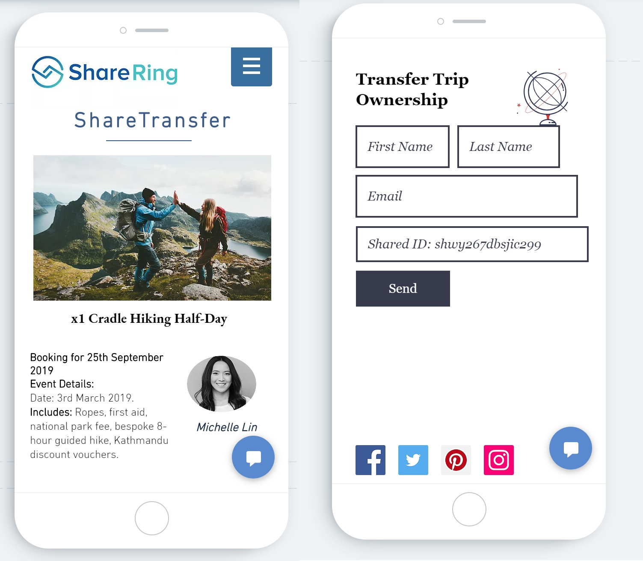
4
ShareTransfer
Instant
Easy
Smart
Faster than a blink
Anyone can do it
Watch the magic
Can’t make it to your activity? Don’t worry transfer it and get your money back.

Slide 6
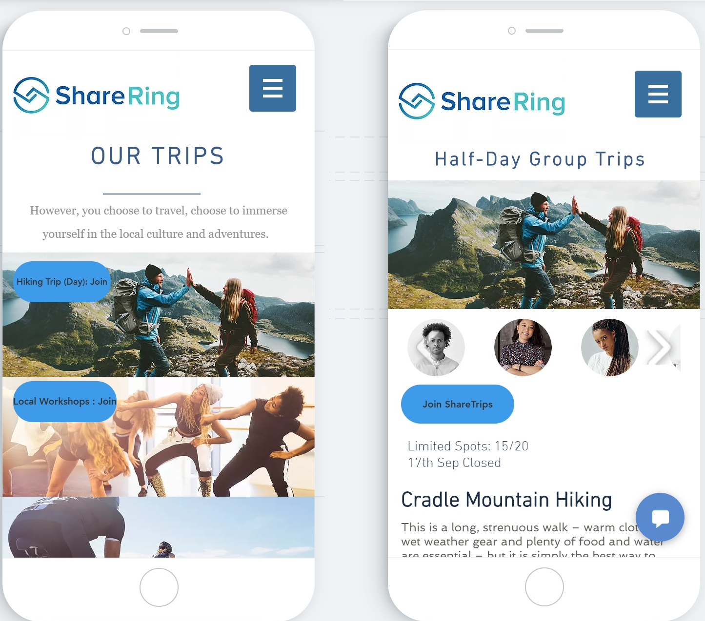
ShareTrip
Safe
Fun
Smart
Travel with verified people
Join on adventures
Watch the magic
Solo or Group join ShareTrip to find your next adventure at split fares.

Slide 7



6
Problem
Travelling is always ruined by the obvious things
Always a few road bumps when travelling
Messy
Difficult
Unsafe
Messy and time consuming
Difficult to follow up or transfer
Can’t trust strangers

Slide 8



7
Solution
Truly making ShareRing a top contender for a travelling companion
Adding to the ShareRing ecosystem:
Share
Transfer
Join
Simplify sharing trip expenses with ShareSimplify
Transfer your trip to a friend with ShareTransfer
Join others on adventures with ShareTrip

Slide 9




9
MARKET OPPORTUNITY
Diverse groups involving travellers, backpackers of all ages can easily use the ShareRing ecosystem.
Backpackers account for 13% of the total tourism spend in Australia, $3.2 Bn.
Share Payments and finding people made Easy.
Transfering booking details never been easy.
Everyone loves travelling.
Notes:
Tourism and Backpacking is one of the most alive market.
In australia itself tourism holds 13% of the market.
we have all travelled in groups and Paying and splitting costs have always been a problem
People wanna travel (Teens Mostly) Also sharing cost and finding people to travel with
these features can really simplify things.

Slide 10


10
COMPETITIVE ADVANTAGES
Features
Cost sharing for groups | ShareSimplify | Yes and no | N/A
Transfer trip booking | ShareTransfer | N/A | N/A
Join an ongoing trip | ShareTrip | N/A | N/A

